Slide 1

Department of Artificial Intelligence and Machine Learning
Acharya Institute of Technology
Soladevanahalli, Bengaluru 560 107
Flipped class Presentation on
DIRECTORY IMPLEMENTATION
Presented by
Group No | Name | USN
9 | DEEPIKA P | 1AY24AI080
 | YASHASWINI | 1AY24AI116
 | PRARTHANA KULKARNI | 1AY24AI118
Guide Name: Mr. Mohammed Tahir Mirji Designation: Assistant Professor
Dept of AI & ML

Slide 2
Background of the topic
In an Operating System, efficient data management is essential for process handling, memory management, and file organization. Linear lists and hash tables are commonly used data structures to organize and access system data effectively.
A linear list maintains data in sequential order and is used in the OS for managing process lists, ready queues, and file control blocks. Its simple structure makes it suitable for ordered data processing.
A hash table provides fast access to data using a hash function and is used in operating systems for quick lookup of process IDs, page tables, and directory entries.
Thus, linear lists and hash tables play an important role in improving the performance and efficiency of operating system functions.
Dept of AI & ML

Slide 3
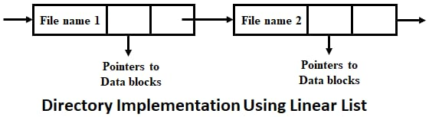
LINEAR LIST
Dept of AI & ML
A linear list is a collection of data elements arranged in a sequential order.
Each element has a unique predecessor and successor, except the first and last elements.
Linear lists can be implemented using arrays or linked lists.
Common operations include insertion, deletion, traversal, and searching.
In operating systems, linear lists are used to manage process control blocks, ready and waiting queues, and file directories.
Searching in a linear list usually takes more time because elements are accessed sequentially.

Slide 4
Linear List:
Advantages
Simple to understand and implement
Easy memory management
Fast for sequential access
Low memory overhead
Disadvantages
Slow search (O(n)) - must traverse sequentially
Slow deletion (O(n)) - requires finding then removing
Performance degrades with large directories
Dept of AI & ML

Slide 5
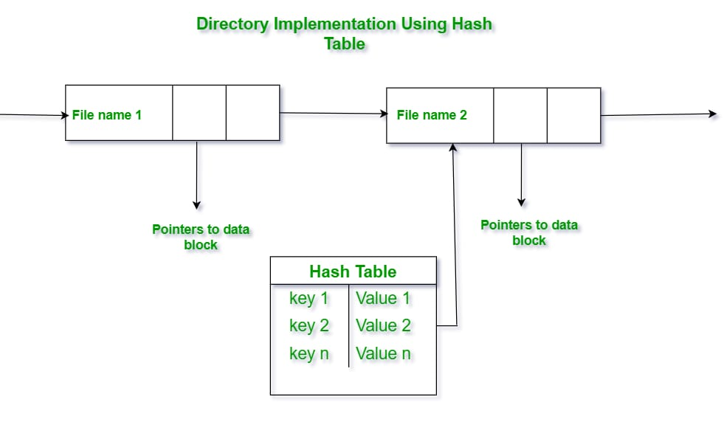
Hash Table
A hash table stores data in the form of key–value pairs.
It uses a hash function to map keys to a specific memory location.
Hash tables provide fast access to data, usually in constant time O(1).
Collisions occur when multiple keys map to the same location.
Collision handling techniques include chaining and open addressing.
In operating systems, hash tables are used for page tables, file indexing, process lookup, and symbol tables.
Dept of AI & ML

Slide 6
HASH TABLE
Advantages
Fast search O(1) average case
Fast insertion O(1) with good hash function
Efficient for large directories
Highly scalable performance
Disadvantages
Collision handling adds complexity
Higher memory overhead than linear lists
Hash function design is critical
Dept of AI & ML

Slide 7
Real-World Applications
Real-World Applications of Linear List
Process Scheduling: Operating systems use linear lists to maintain ready, waiting, and blocked process queues.
Music/Video Playlists: Songs or videos are stored in sequence and played one after another.
Task Management: To-do lists and job queues follow a linear order.
Undo/Redo Operations: Text editors store actions in a linear list.
Memory Management: Free memory blocks can be maintained in a linear list.
Railway Reservation Lists: Passenger names are stored in an ordered list.
Real-World Applications of Hash Table
Database Indexing: Used to quickly locate records using a key.
File Systems: Hash tables help in fast file name lookup.
Password Authentication: Passwords are stored and verified using hash functions.
Symbol Tables: Compilers and operating systems use hash tables to store symbols.
Caching Systems: Web browsers and operating systems use hash tables for quick cache access.
Routing Tables: Network devices use hash tables for fast address lookup.
Dept of AI & ML

Slide 8
Interactive Activity / Question
Why is a linear list preferred over a hash table for managing ready and waiting queues in an operating system? Explain with reasons.
If an operating system needs to quickly find a process using its process ID, which data structure would be more suitable: a linear list or a hash table? Justify your answer.
Dept of AI & ML

Slide 9
Thank You
Dept of AI & ML

